Slide 1
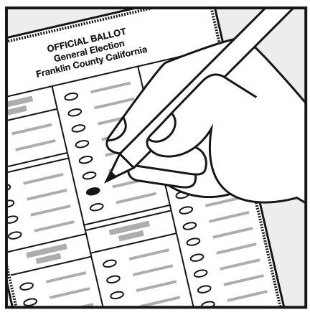
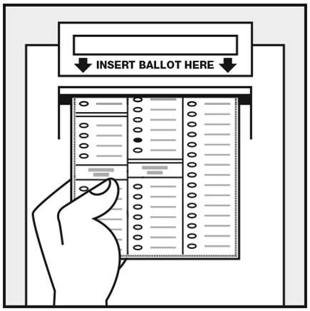
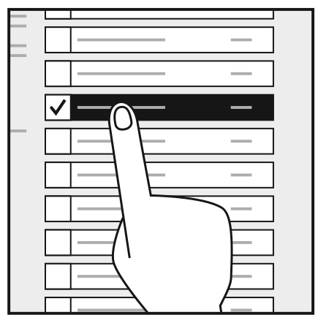
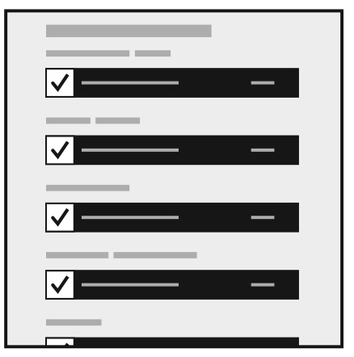
To vote on a paper ballot
Make your selection by filling in the oval next to your choice(s).
When you’re done, scan your ballot.
To vote on a touchscreen
Make your selections on the screen.
Check your votes before you cast your ballot

