Slide 1
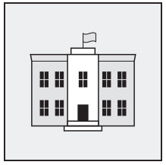
Serving as a poll worker is a great way to serve your community, witness democracy firsthand, and make some extra cash.
We invite you to join our valued team of poll workers!
To serve as a poll worker, you must:
Be a registered voter in the county
Attend a training session. You’ll be paid for your time!
Work at the polling place from 6:00 a.m. – 8:30 p.m.
Treat all voters with kindness and patience
Be capable of lifting 25 lbs.
Ready to join us?
Pick up a paper application in our office at 111 Main St. in Middleton or apply online at countyelections.org/poll-workers.

