Slide 1
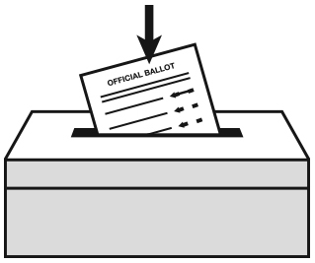
At the polls on Election Day
Polls are open on Election Day, November 6, 6:00 a.m. – 7:00 p.m.
Look up your polling place
• Online at countyelections.org
• By calling the State Department of
Elections at 555-555-5555
In person before Election Day
You may qualify to vote early at the voter registration office. Learn more at countyelections.org. Early voting period: September 21 – November 3.
By mail as an absentee voter
Request an absentee ballot by 5:00 p.m. on October 30 at countyelections.org. Return it by mail, deliver it to the voter registration office, or drop it at your polling place on Election Day.

